Slide 1

REA accounting for the climate
https://valueflo.ws

Slide 2
REA Accounting for the Climate
REA
REA stands for Resources, Events, Agents.
It started out as an enterprise accounting model but has developed into an overall economic model for networks.
The traditional double entry accounting (Assets - Liabilities = Owner Equity) model does not work for networks, because a network does not have a singular ownership.
The REA economic model does work.
Climate accounting for the earth’s networks of resource flows needs REA or something like it.

Slide 3
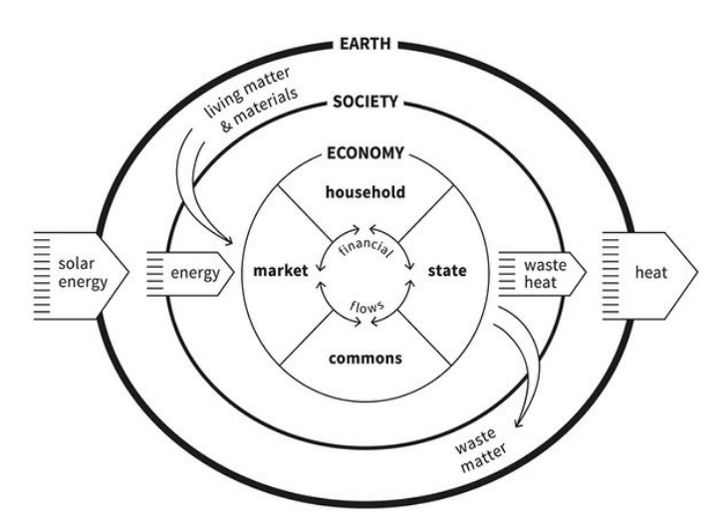
REA Accounting for the Climate
Value Flows
Value Flows is a set of common open vocabularies based on REA. It describes flows of economic resources of all kinds within networked economic ecosystems.
But it works for everything in this version of Kate Raworth’s doughnut model, not just the Economy circle.
And it’s a lot easier to record and analyze all these circles of resource flows with a common vocabulary.

Slide 4
REA Accounting for the Climate
REA core definitions
Agents are Economic Agents, who perform Economic Events affecting Economic Resources. Agents can be individual persons or organizations.
An Economic Event can take actions like create, change, consume, use, or destroy Economic Resources, or transfer them from one Agent to another, or transport them from one place to another.
Economic Resources could be
Useful goods and services
Money, tokens, credits
Energy
Labor power, skills
Pollutants, CO2, methane, heat
Air, water, soil microbiota

Slide 5
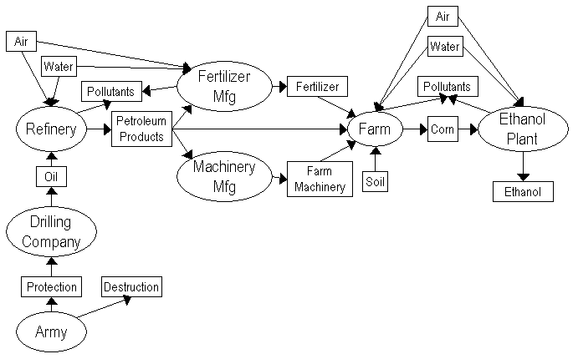
REA Accounting for the Climate
Input-Process-Output
The basic pattern for modeling resource flows is input-process-output. Resource flows can be of any length, or circular.
Resource flows can be traced and tracked, to see the whole history of a resource, or what happened to a resource after it was produced.

Slide 6
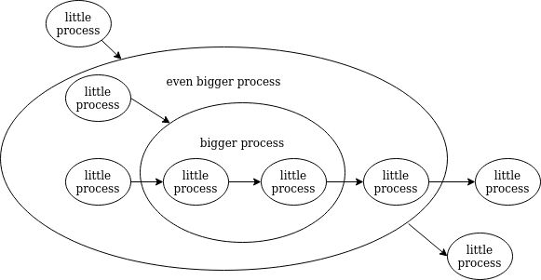
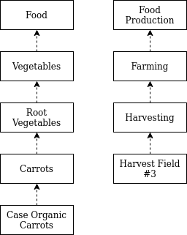
REA Accounting for the Climate
This works at different levels...
Notes:
Can record at different levels;
can aggregate to higher levels;
can use information gained from higher levels to make decisions for lower levels.
Taxonomies, etc.

Slide 7



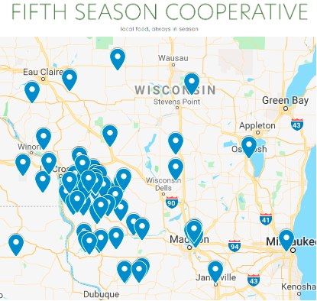


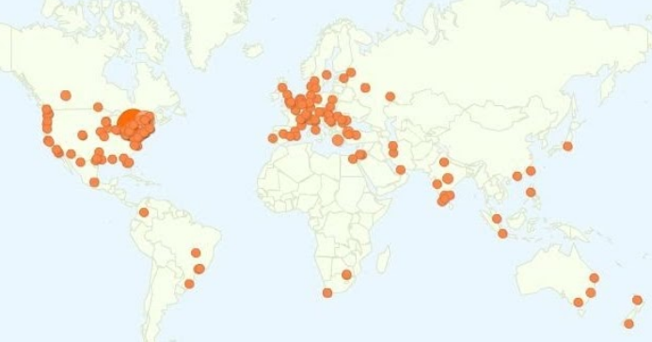
REA Accounting for the Climate
Operations
Notes:
Fifth Season – multi-stakeholder
Sensorica and GT – contribution accounting
FairCoop – focused more on crypto-currency and other financial services
LearnDeep – high school fablab network

Slide 8
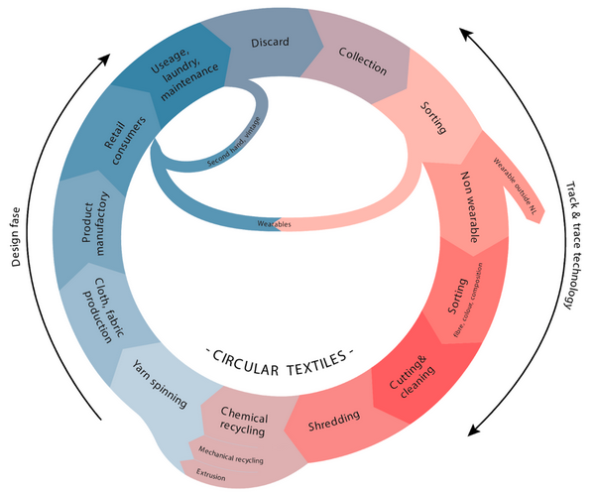
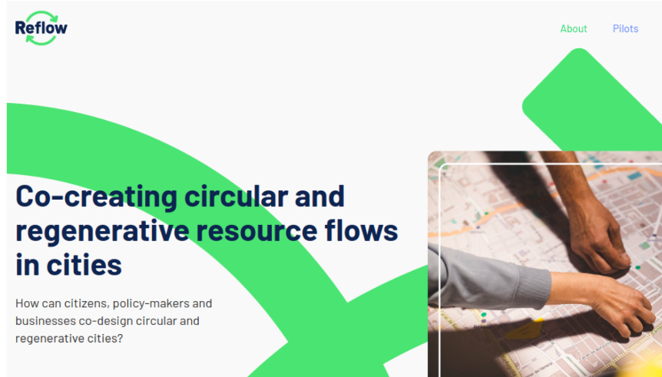
REA Accounting for the Climate
Municipal
Reflow is a project in process that is using Value Flows for municipality-wide circular economy projects in Europe.
In Amsterdam, they are working with the textile industry.
Notes:
6 pilots, each focusing on one industry, working with operational and analytical levels

Slide 9

REA Accounting for the Climate
Provincial
This was done with a group in Nova Scotia with a group called Ecology Action Center, at the provincial level. We can see the comparison of different fishing methods, and their effects on fishing grounds.
Notes:
A regional scope, again one industry. From this analysis, they created a co-op for sustainable fishing and markets for the co-op

Slide 10
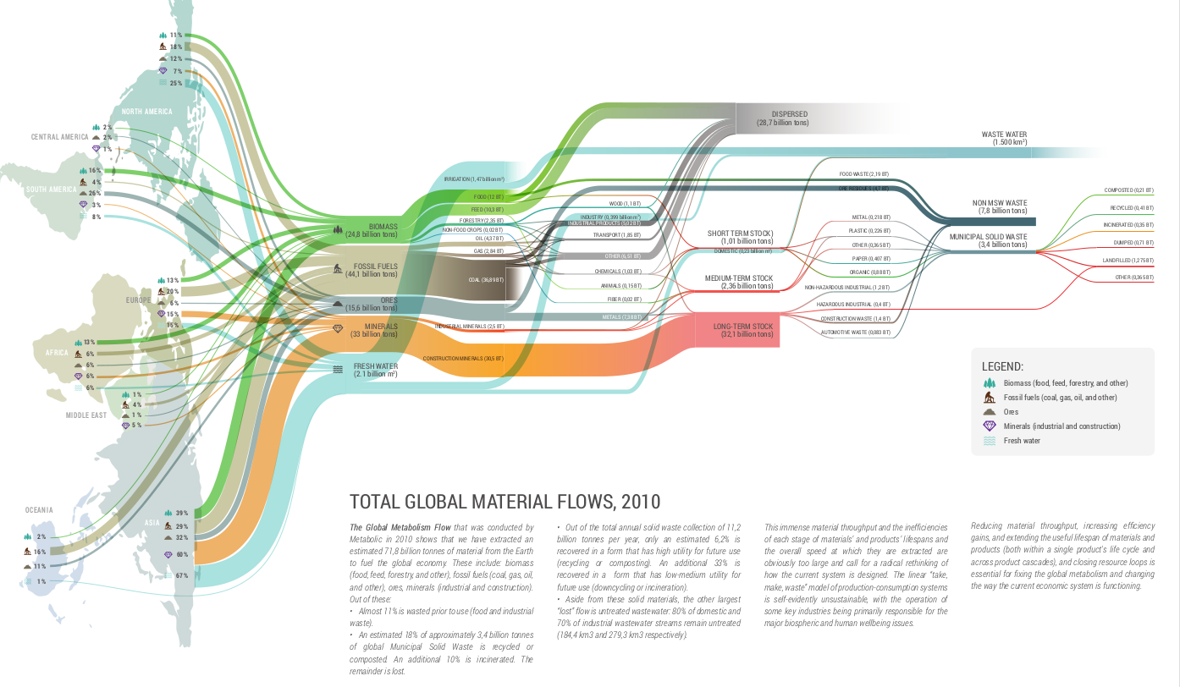

REA Accounting for the Climate
…. or global
Notes:
We were not working with Metabolic when they created this, but it is a great example of visualization of global resource flows.

Slide 11
REA Accounting for the Climate
Ways to contribute
Use Value Flows for your project, we can help you model your flows and map to Value Flows. More use cases are always helpful for the vocabulary.
Contribute to the Value Flows vocabulary project, https://gitter.im/valueflows/welcome.
If Value Flows can contribute anything to the protocols for the Climate Collabathon, we are happy to help with that.

Slide 12
REA Accounting for the Climate
Links and references
Value Flows documentation: http://valueflo.ws
REA links: https://valueflo.ws/appendix/rea.html
Kate Raworth’s doughnut: https://www.kateraworth.com/
Fifth Season Cooperative: http://www.fifthseasoncoop.com/
Sensorica: https://www.sensorica.co/
Guerrilla Translation: https://www.guerrillatranslation.org/
LearnDeep: https://learndeep.org/
FairCoop: https://wiki.fair.coop/en:faircoop:start
Nova Scotia fish project: http://locecon.org/nova-story/
Reflow: https://reflowproject.eu/
Metabolic: https://www.metabolic.nl/
Notes:
In the order they appeared in the slides

